Slide 1
Task 3 -Ethical Hacking
-Finding Vulnerabilities using Burp Suite

Slide 2
Report
CROSS SITE SCRIPTING(XSS)
The Vulnerability test was done on the domain Vulnweb.com
Subdomain was http://testasp.vulnweb.com/
Cross Site Scripting Vulnerability was found on the site
About Cross Site Scripting:Cross-site scripting (XSS) is a type of security vulnerability that can be found in some web applications. XSS attacks enable attackers to inject client-side scripts into web pages viewed by other users. A cross-site scripting vulnerability may be used by attackers to bypass access controls such as the same-origin policy.

Slide 3
IMPACT OF CROSS SITE SCRIPTING
Cross site scripting attacks can have devastating consequences. Code injected into a vulnerable application can exfiltrate data or install malware on the user’s machine. Attackers can masquerade as authorized users via session cookies, allowing them to perform any action allowed by the user account.
XSS can also impact a business’s reputation. An attacker can deface a corporate website by altering its content, thereby damaging the company’s image or spreading misinformation. A hacker can also change the instructions given to users who visit the target website, misdirecting their behavior. This scenario is particularly dangerous if the target is a government website or provides vital resources in times of crisis.

Slide 4
MITIGATION
Filter input on arrival. At the point where user input is received, filter as strictly as possible based on what is expected or valid input.
Encode data on output. At the point where user-controllable data is output in HTTP responses, encode the output to prevent it from being interpreted as active content. Depending on the output context, this might require applying combinations of HTML, URL, JavaScript, and CSS encoding.
Use appropriate response headers. To prevent XSS in HTTP responses that aren't intended to contain any HTML or JavaScript, you can use the Content-Type and X-Content-Type-Options headers to ensure that browsers interpret the responses in the way you intend.
Content Security Policy. As a last line of defense, you can use Content Security Policy (CSP) to reduce the severity of any XSS vulnerabilities that still occur.
Filter input on arrival. At the point where user input is received, filter as strictly as possible based on what is expected or valid input.
Encode data on output. At the point where user-controllable data is output in HTTP responses, encode the output to prevent it from being interpreted as active content. Depending on the output context, this might require applying combinations of HTML, URL, JavaScript, and CSS encoding.
Use appropriate response headers. To prevent XSS in HTTP responses that aren't intended to contain any HTML or JavaScript, you can use the Content-Type and X-Content-Type-Options headers to ensure that browsers interpret the responses in the way you intend.
Content Security Policy. As a last line of defense, you can use Content Security Policy (CSP) to reduce the severity of any XSS vulnerabilities that still occur.

Slide 5
Steps to find the vulnerability:
Click on http://testasp.vulnweb.com/
Click on the search tab in the site
User will be redirected to a page with a search box
Change to proxy settings to “manual” so as to use Burp Suite
Intercept the request in Burp Suite
Send request to the intruder and paste different payloads for XSS(Different payloads for XSS can be found on searching it on your browser)
Find the successful payload for XSS
The videos and screenshots have been uploaded in the following slides

Slide 6
Video -Link to acess the video recording of Burp Suite attached below https://drive.google.com/file/d/1wBGdx7uRvFQMT43fRSKVSqPZCbJdtB4V/view?usp=sharing

Slide 7
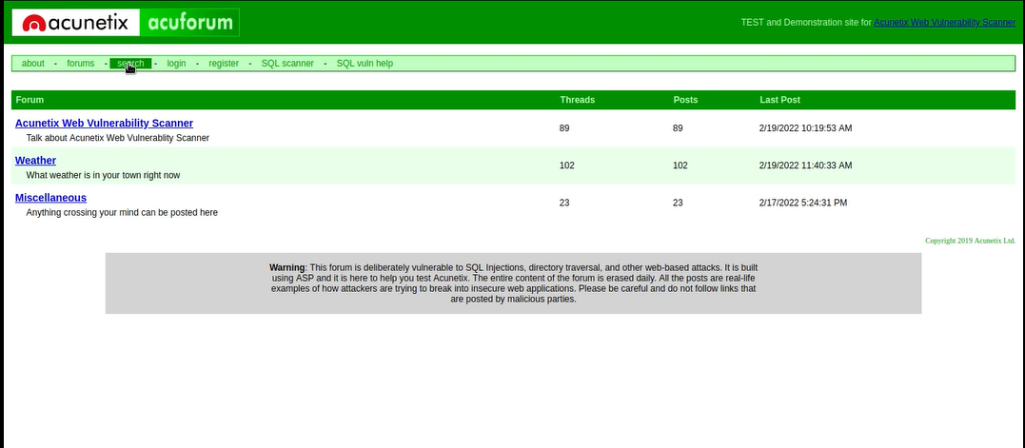
SCREENSHOTS

Slide 8
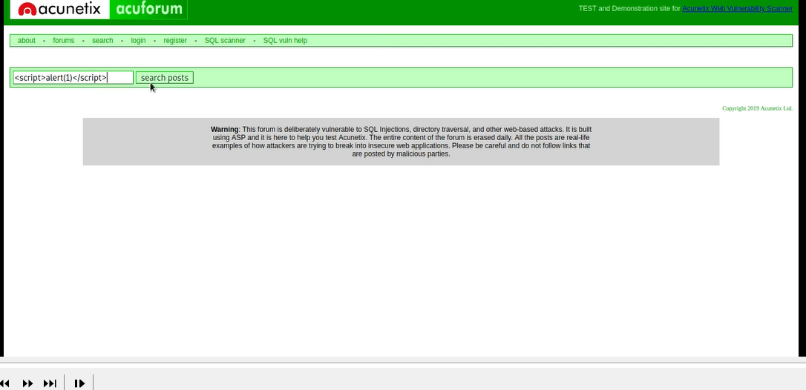

Slide 9
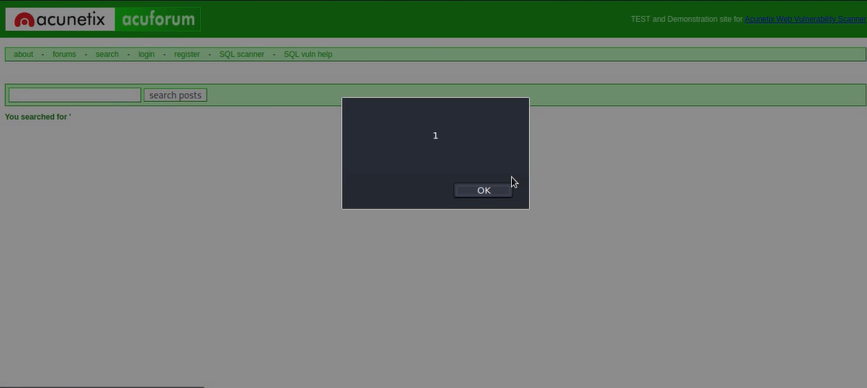

Slide 10
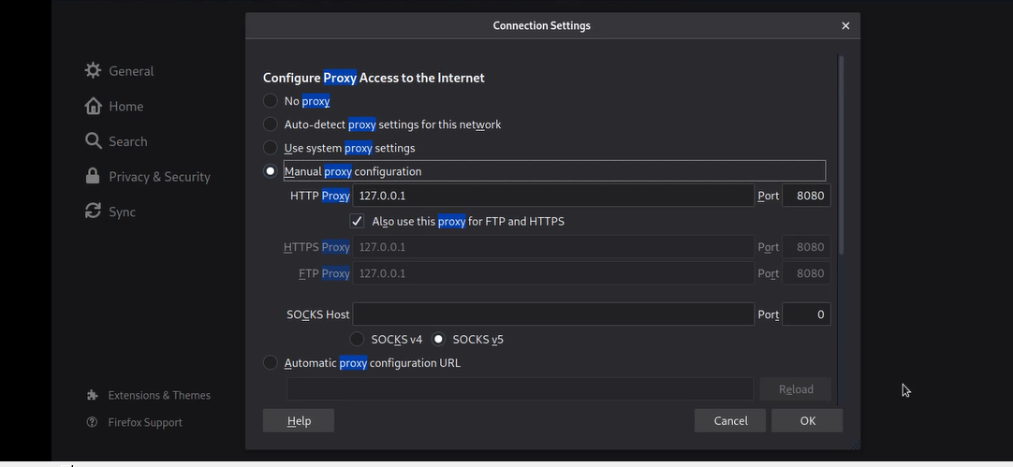

Slide 11
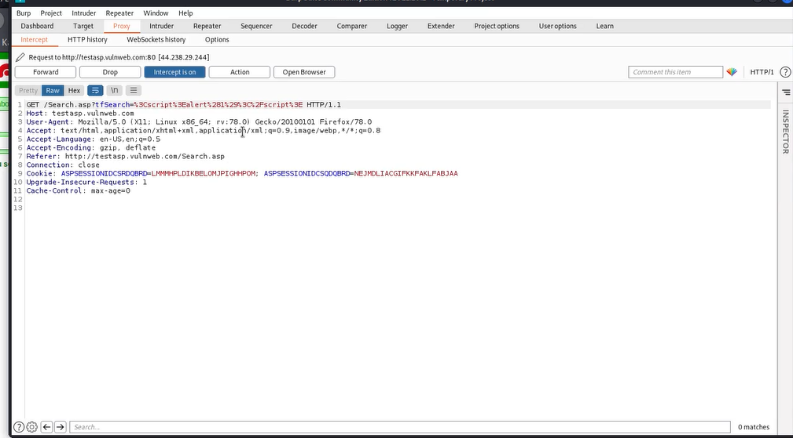

Slide 12
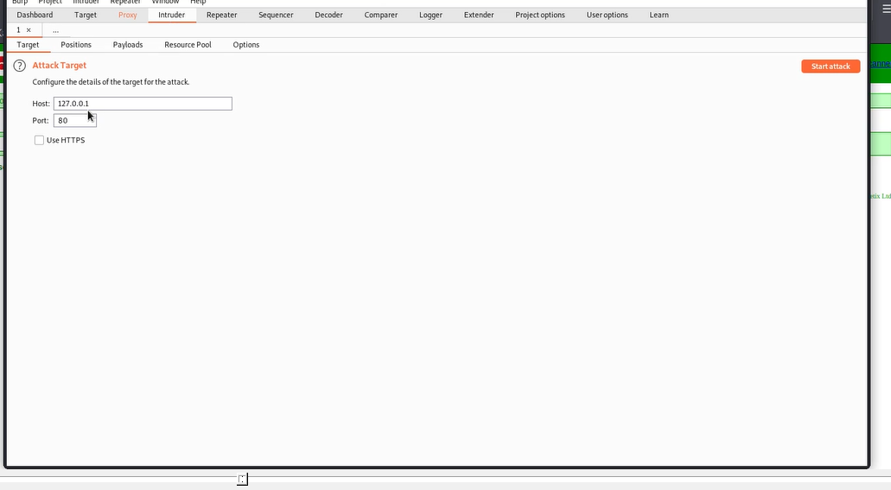

Slide 13
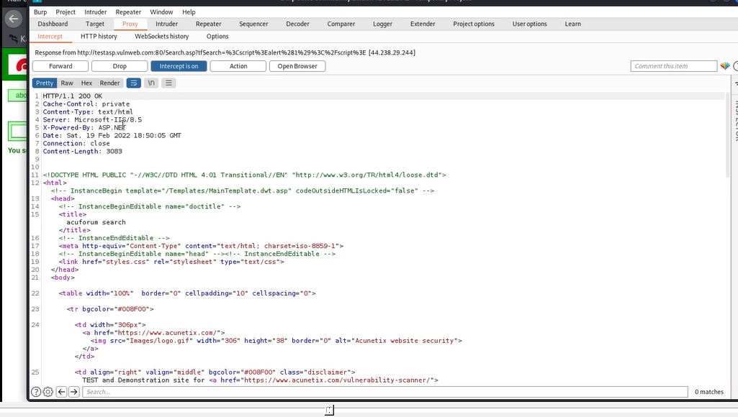

Slide 14
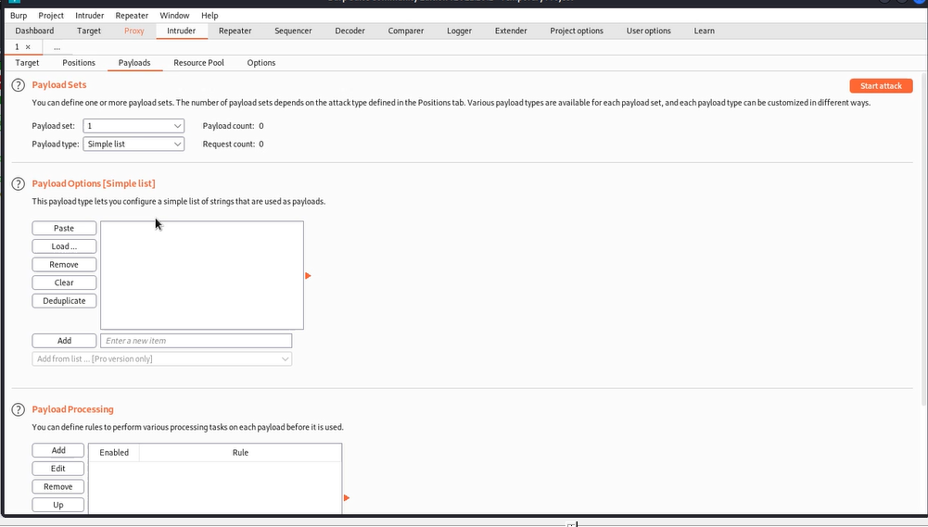

Slide 15


